Slide 1
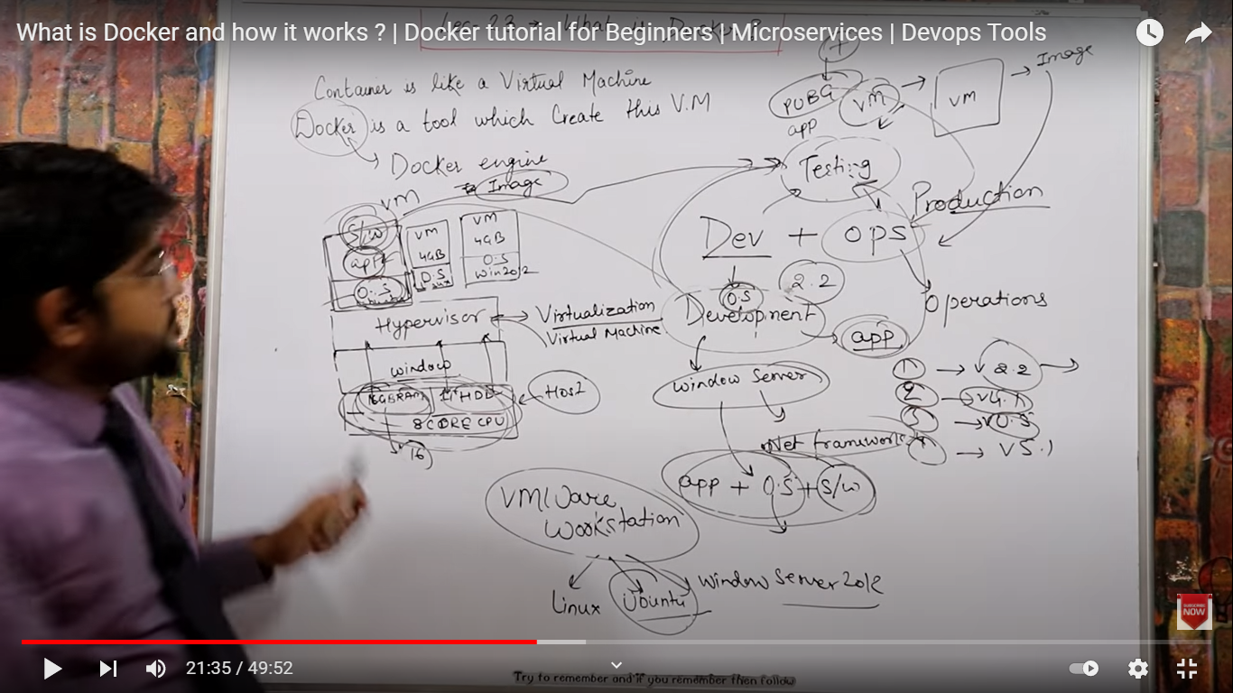

Slide 2
https://www.section.io/engineering-education/django-docker/
https://testdriven.io/blog/dockerizing-django-with-postgres-gunicorn-and-nginx/

Slide 3
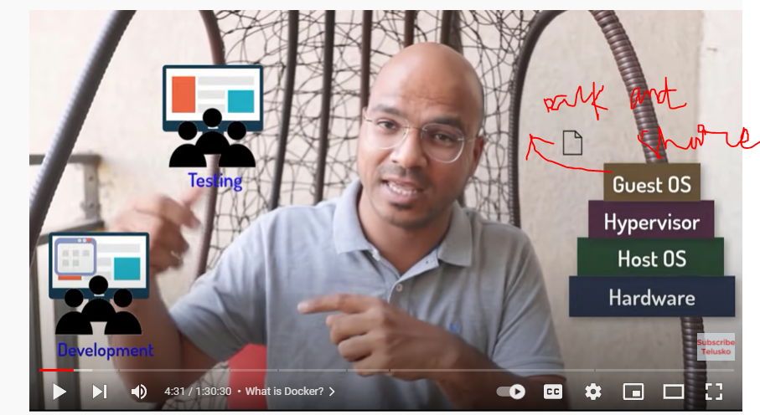
https://www.youtube.com/watch?v=GGaDSAMeopo&t=1264s
vmware

Slide 4
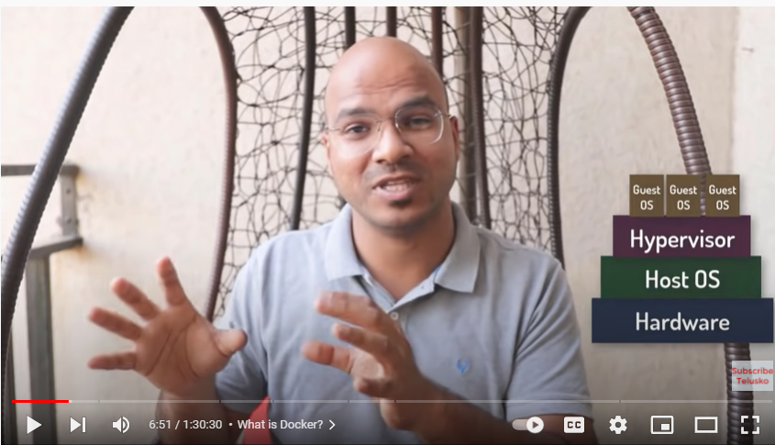

Slide 5
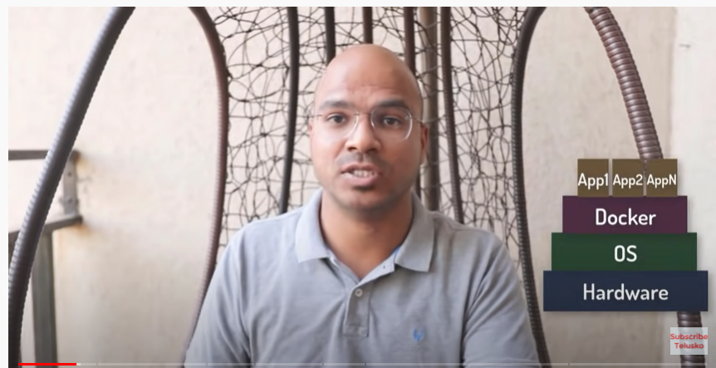

Slide 7
Telusko tutorial
There are two ways to use Docker
Create your own project and dockerize it
Create your project on top of Docker
1. Create your own project and dockerize it
docker-compose build
Docker-compose up

Slide 8
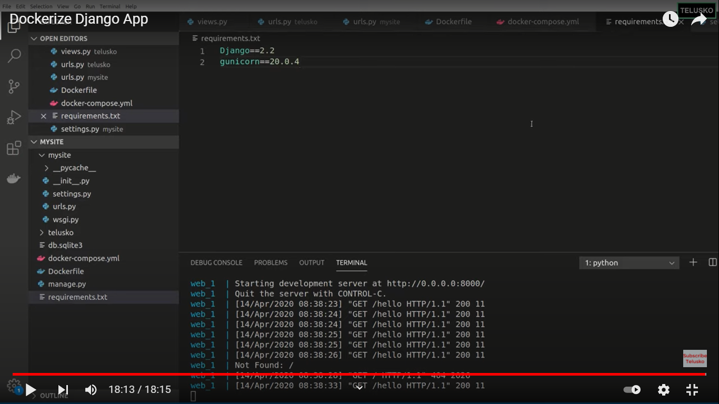

Slide 9
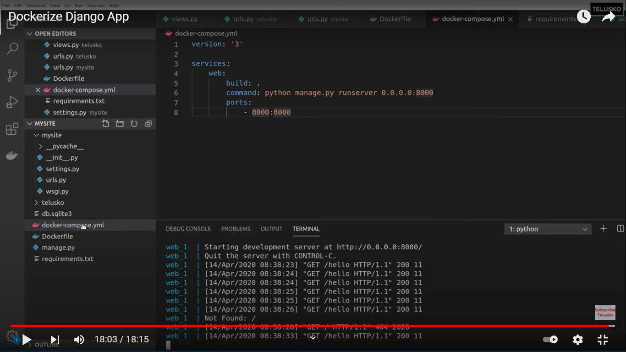

Slide 10
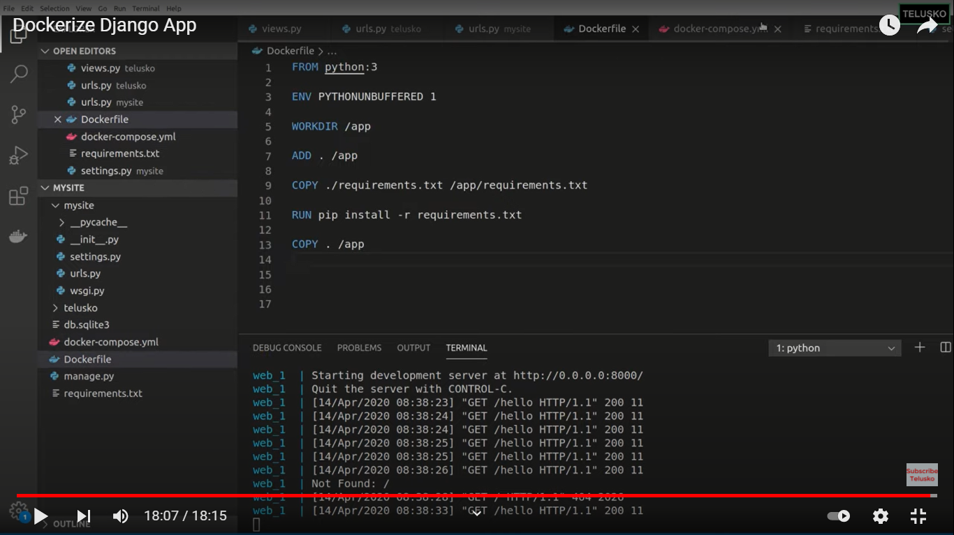

Slide 11
1. Create your own project and dockerize it

Slide 12
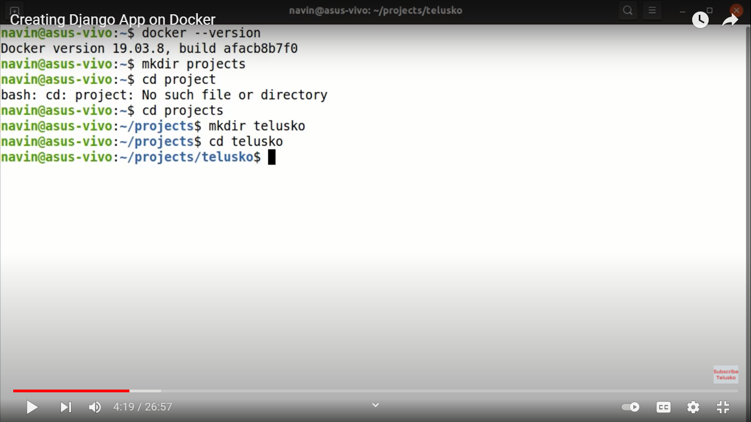

Slide 13
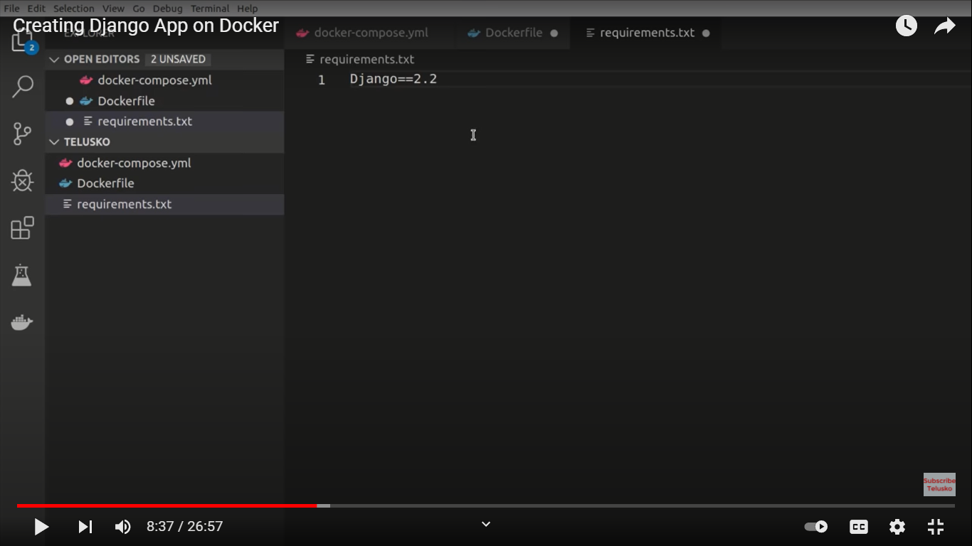

Slide 14
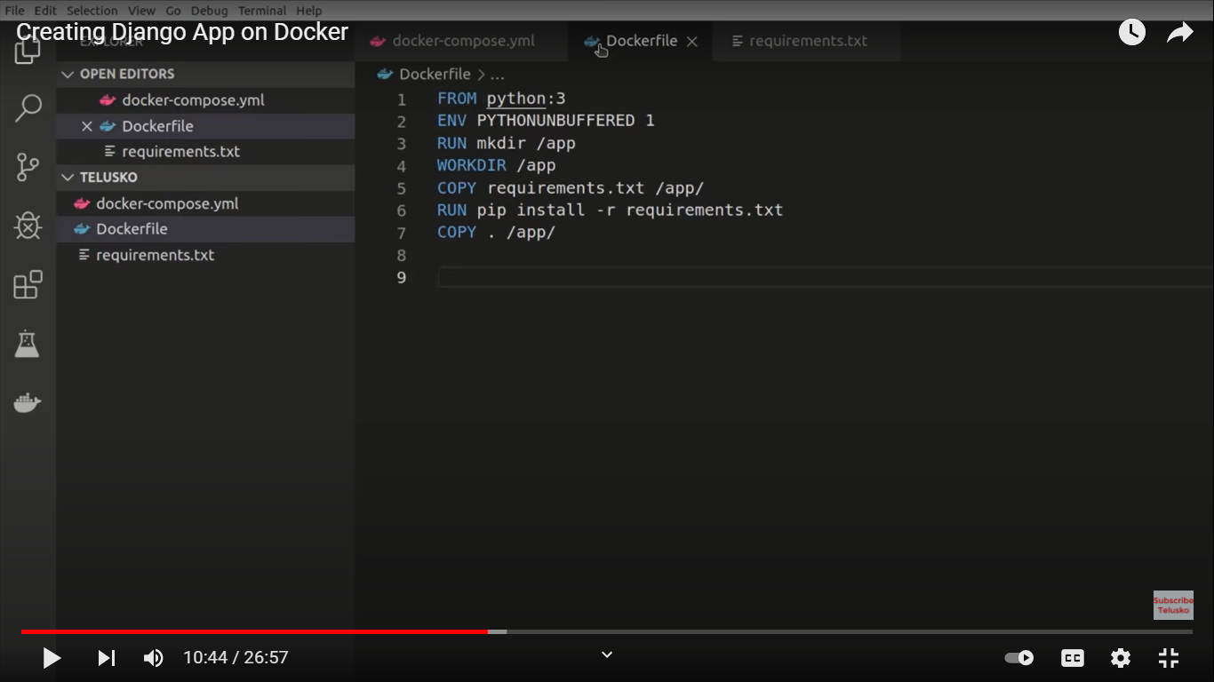

Slide 15
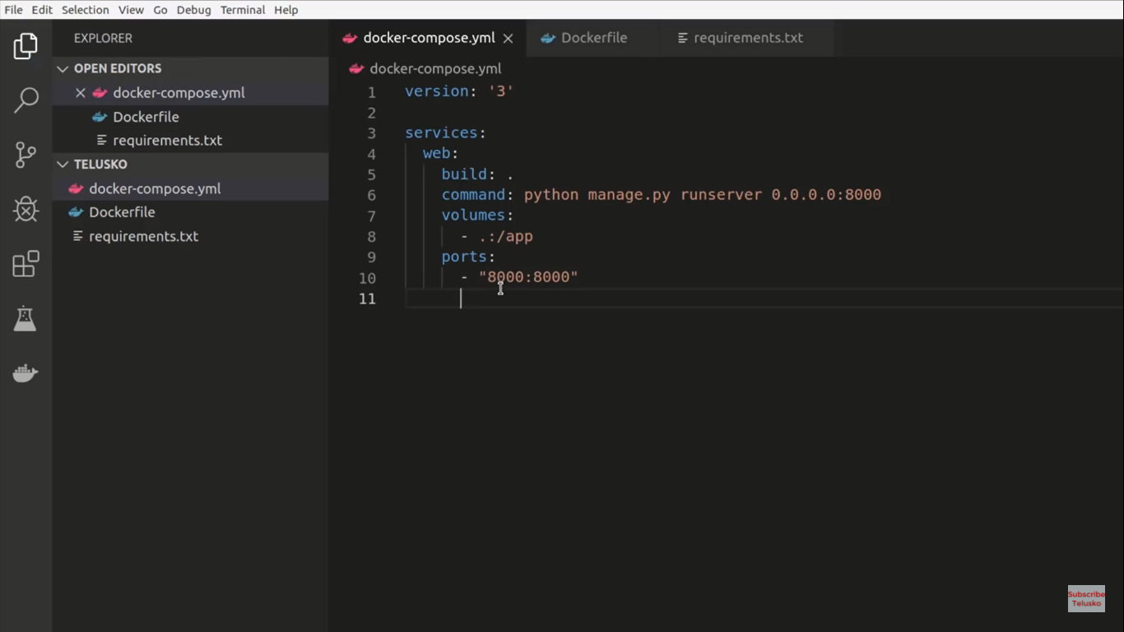

Slide 16
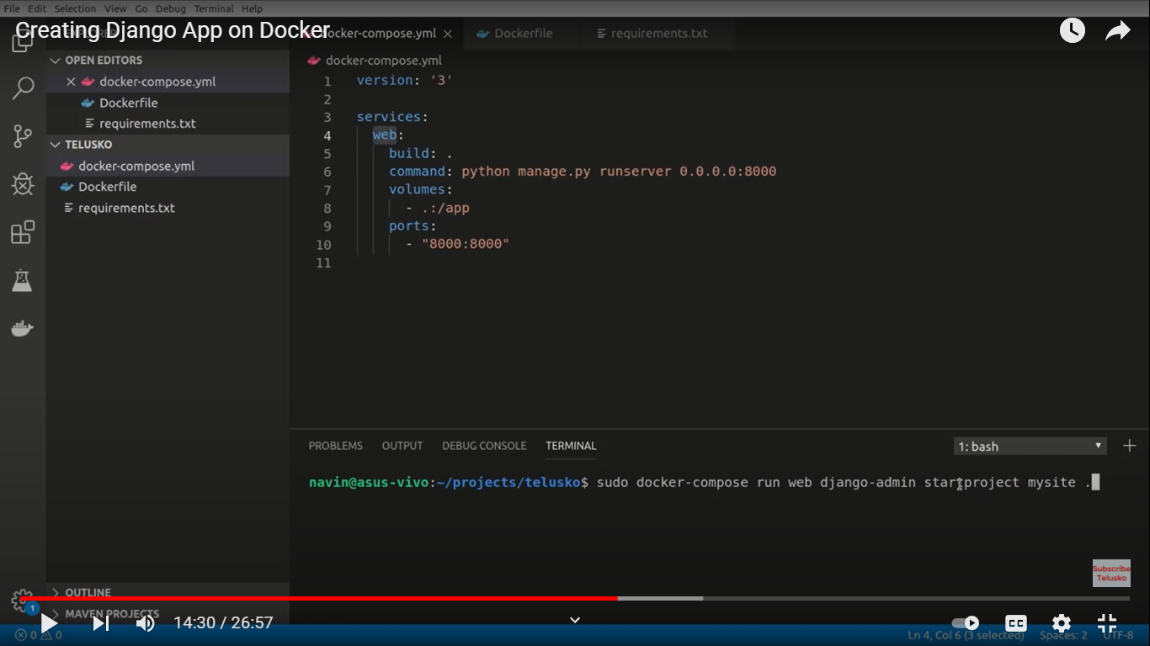

Slide 17
Run below command:
docker-compose run web python manage.py makemigrations
docker-compose run web python manage.py migrate
docker-compose up
docker-compose down

Slide 18
Run below command:
ls –l
This will give some root user, we need to convert to user permission , apply below command
sudo chown –R $USER:$USER .
docker-compose up → start container
Got to browser and type:
127.0.0.1:8000

Slide 19
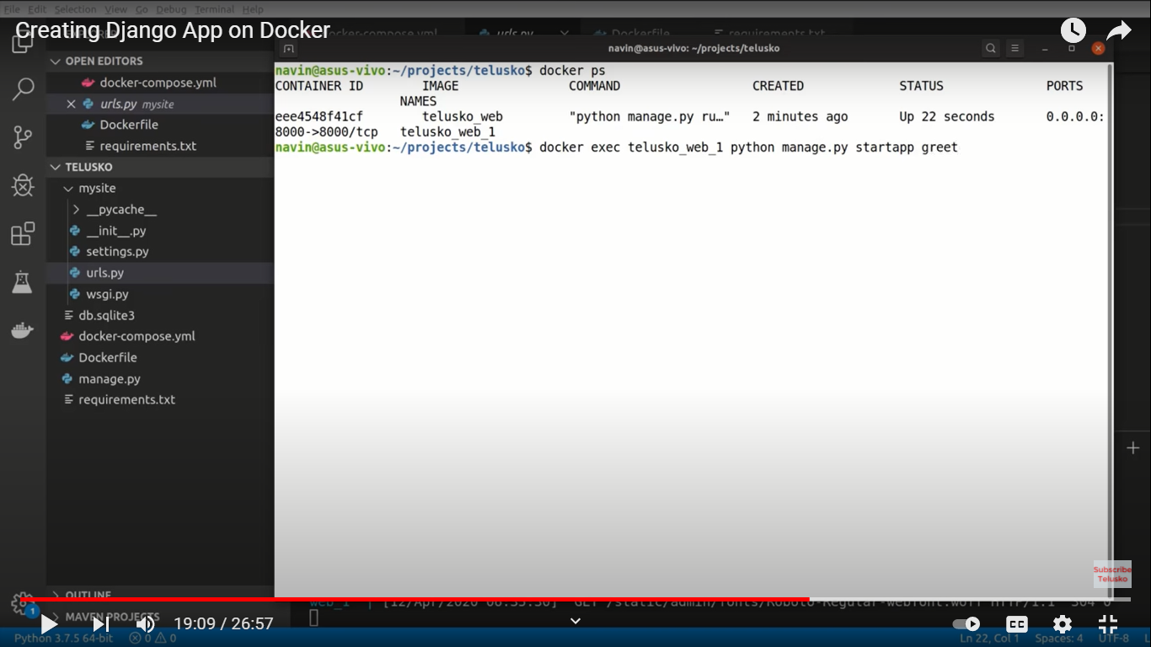

Slide 20
https://www.youtube.com/watch?v=jyapP2Yy0AQ
Another tutorial

Slide 21
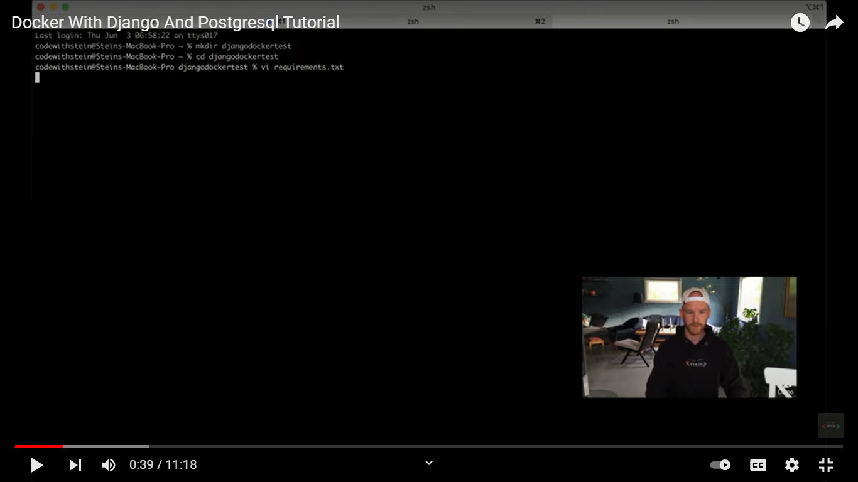

Slide 22
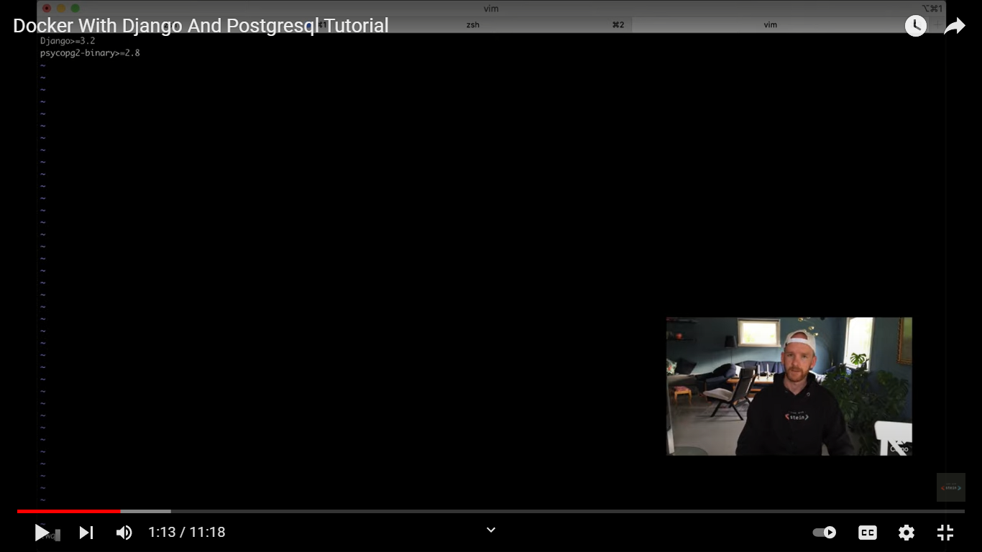

Slide 23
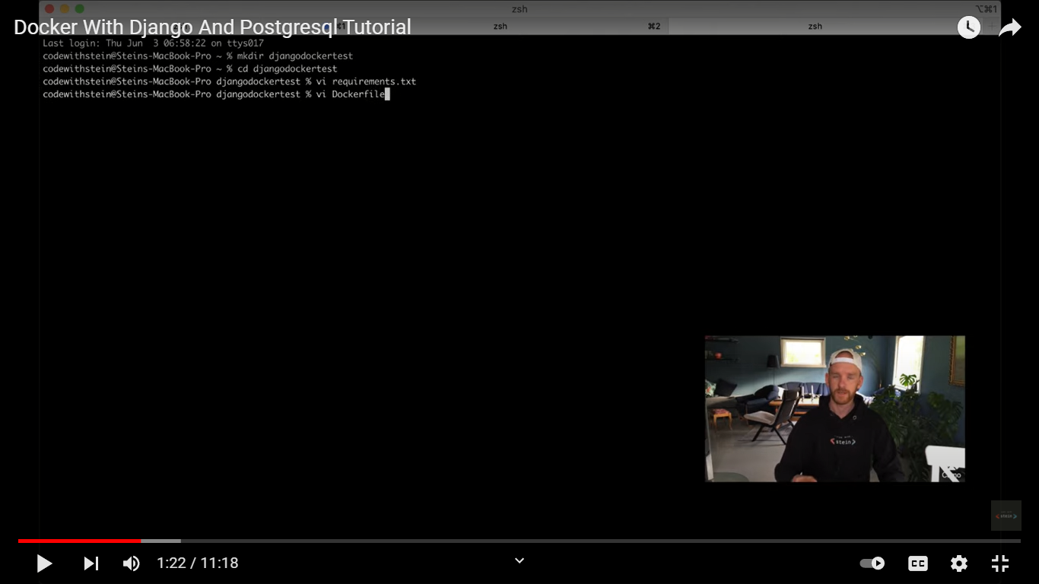

Slide 24
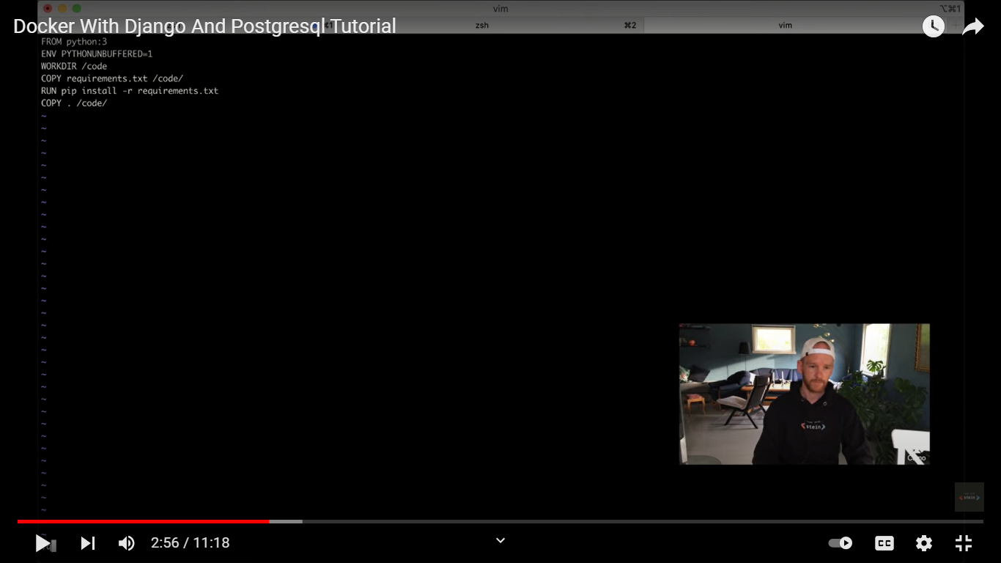

Slide 25
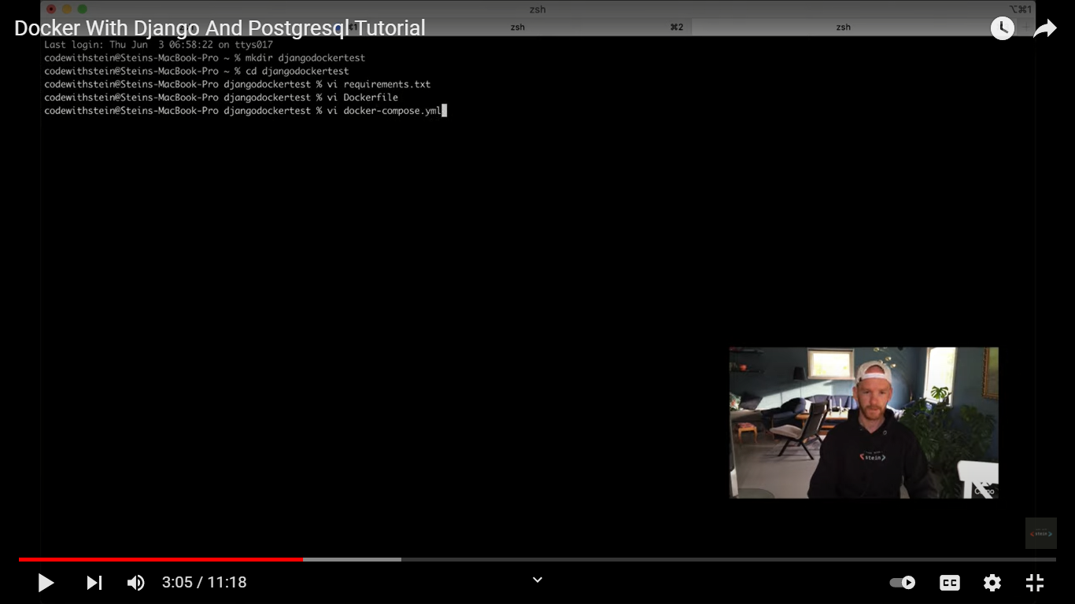

Slide 26
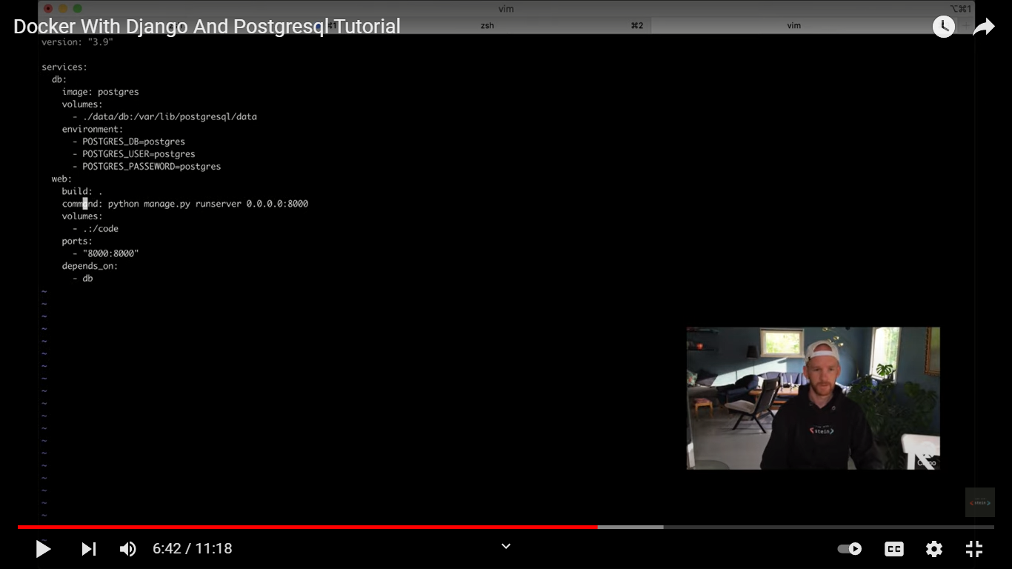

Slide 27
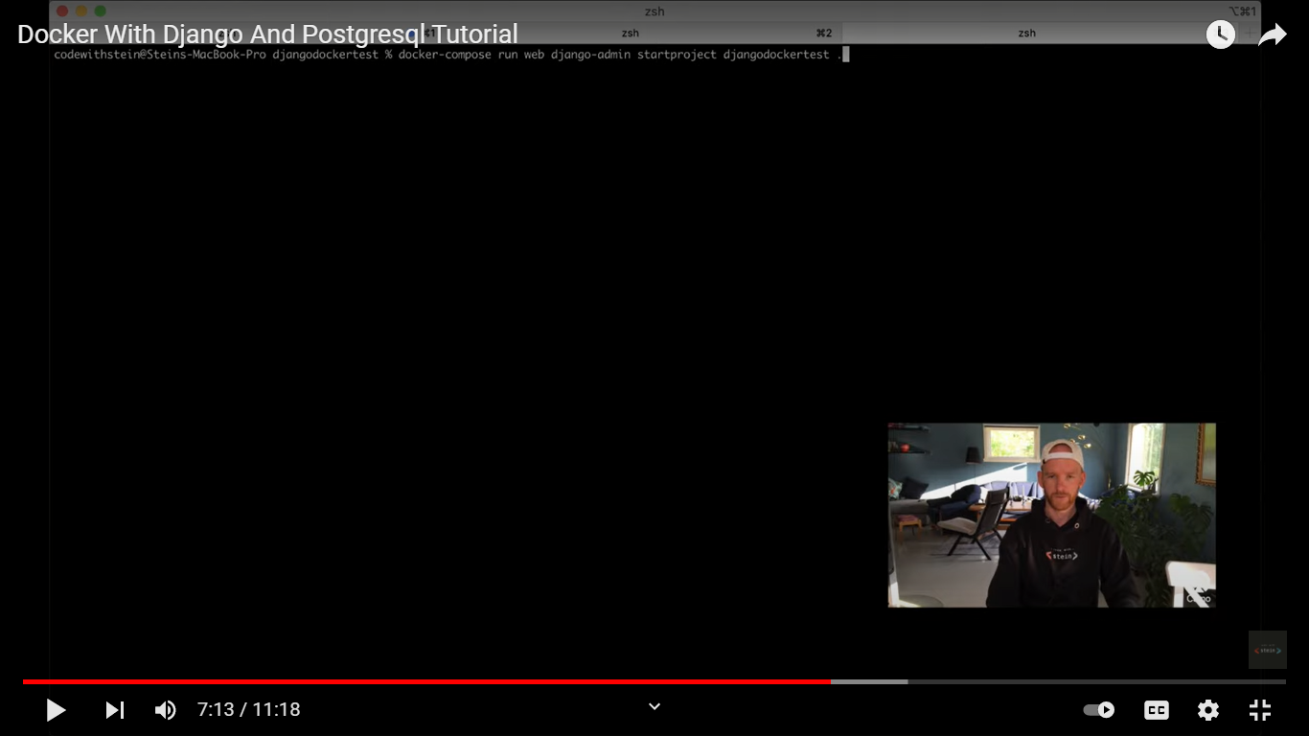

Slide 28
Set database in setting file
ALLOWED_HOSTS =[“0.0.0.0”]

Slide 29
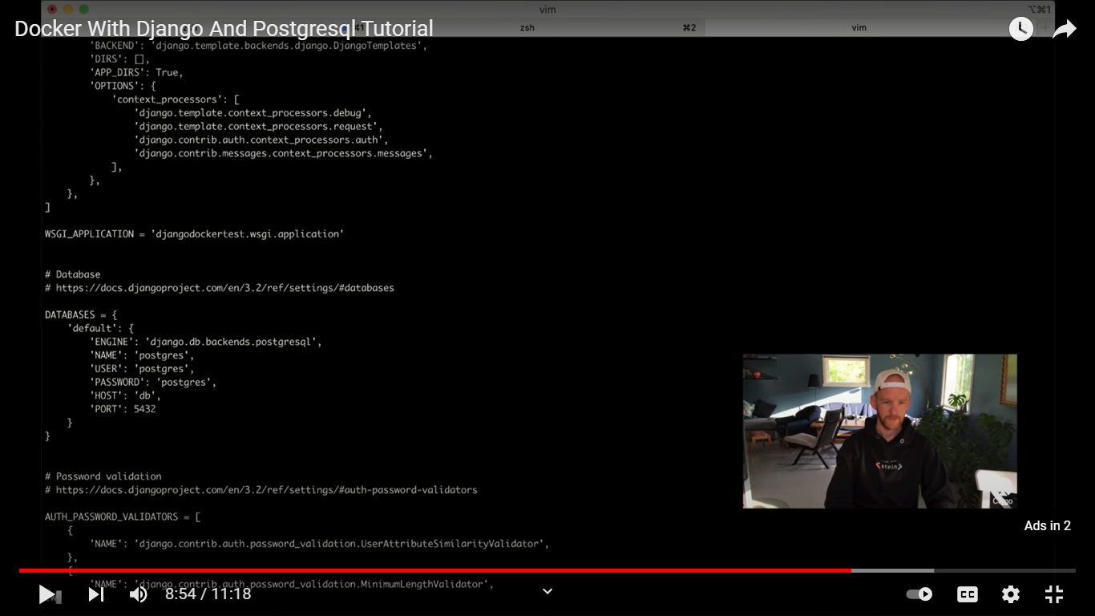

Slide 30
Dockerize Django App
Telusko tutorial
https://www.youtube.com/watch?v=oiZRUR20tk4

